Slide 1


Predictive Maintenance for Smart Grids in musurume growth using data mining. using Apriory Algorithm
Y.Saikiran-192211713
.

Slide 2
Introduction to Predictive Maintenance for Smart Grids
Predictive maintenance is a proactive approach to managing the health of electrical grids. By analyzing data from smart sensors, utilities can predict equipment failures and perform targeted maintenance, improving grid reliability and efficiency.

Slide 3

Overview of Musurume Growth and its Challenges
Population Increase
1
Musurume's population has grown rapidly, straining the capacity of existing infrastructure.
2
Urbanization Trends
People are moving from rural areas to cities, creating new demand for electricity and grid modernization.
Economic Development
3
As Musurume's economy expands, energy consumption is rising, requiring more reliable and flexible power grids.

Slide 4
The Role of Data Mining in Predictive Maintenance
Sensor Data Analysis
Predictive Models
Prescriptive Insights
Collecting and analyzing real-time data from grid sensors can reveal patterns and anomalies that predict equipment failures.
Advanced analytics and machine learning techniques can build predictive models to forecast maintenance needs and optimize grid operations.
Data mining provides actionable recommendations to prioritize maintenance tasks and allocate resources effectively.

Slide 5
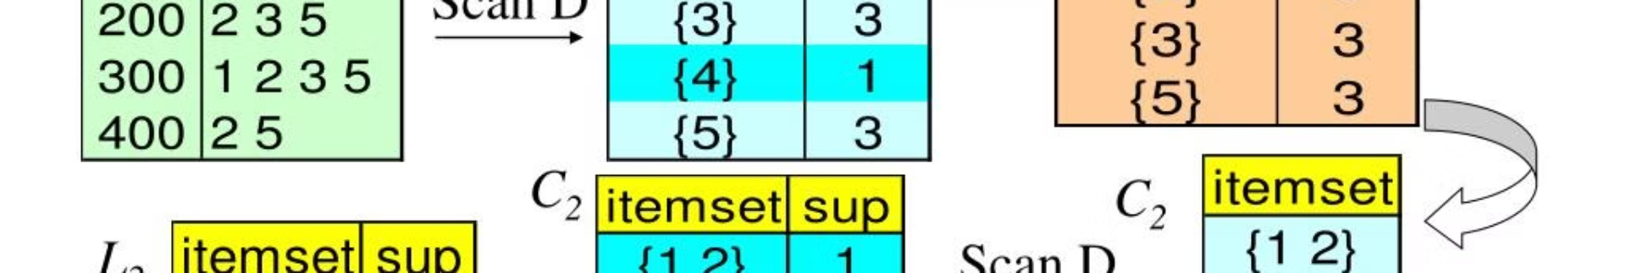
Apriory Algorithm: Principles and Applications
1
Identify Frequent Itemsets
2
Association Rule Mining
3
Efficiency and Scalability
The Apriori algorithm discovers frequently occurring patterns in transaction data, such as equipment failures and their causes.
It then generates association rules that describe the relationships between these frequent itemsets, enabling predictive maintenance.
Apriori is an efficient algorithm that can handle large volumes of grid sensor data in real-time.

Slide 6
Data Collection and Preprocessing for Smart Grid Predictive Maintenance
Sensor Data Integration
Data Cleaning and Normalization
Collect and consolidate data from various grid sensors, including voltage, current, and temperature readings.
Preprocess the data to handle missing values, outliers, and ensure consistent data formats.
Feature Engineering
Data Enrichment
Extract relevant features from the sensor data to train predictive maintenance models effectively.
Combine sensor data with other sources, such as weather and maintenance records, to enhance the predictive capabilities.

Slide 7
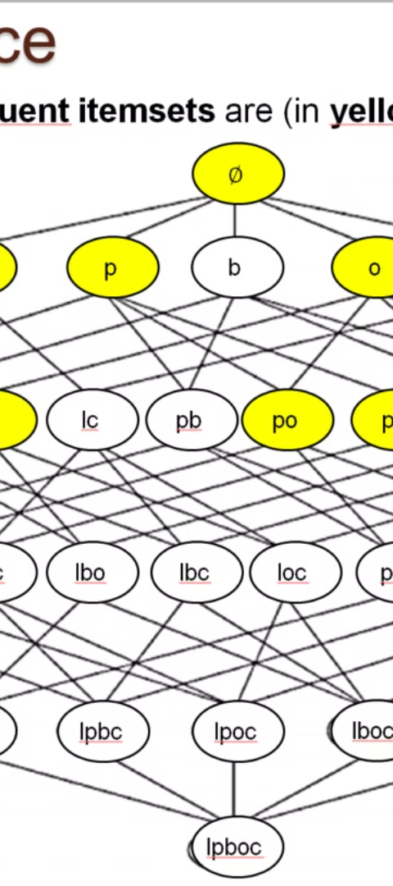



Implementing Apriory Algorithm for Predictive Maintenance
Data Preparation
Transform the sensor data into a format suitable for the Apriori algorithm, such as transaction datasets.
Frequent Itemset Mining
Apply the Apriori algorithm to identify frequent patterns of equipment failures and their contributing factors.
Association Rule Generation
Generate association rules that describe the relationships between the frequent itemsets, enabling predictive maintenance insights.

Slide 8




Analyzing Predictive Maintenance Insights and Optimizing Grid Performance
Grid Reliability
Optimized Maintenance
Energy Efficiency
Cost Savings
Predict and prevent equipment failures to ensure uninterrupted power supply.
Identify opportunities to reduce energy losses and improve grid performance.
Avoid unnecessary repairs and reduce unplanned downtime, leading to cost savings.
Prioritize maintenance tasks and allocate resources based on predicted needs.

Slide 9
Conclusion and Future Considerations
Continuous Improvement
Emerging Technologies
Collaborative Approach
Regularly review and refine the predictive maintenance models to keep up with evolving grid conditions and new data sources.
Explore the integration of advanced technologies, such as IoT, cloud computing, and AI, to enhance the predictive maintenance capabilities.
Foster partnerships between utilities, technology providers, and research institutions to drive innovation and best practices in smart grid predictive maintenance.

Slide 10

References
1
IEEE Transactions on Smart Grid
2
Journal of Modern Power Systems and Clean Energy
https://ieeexplore.ieee.org/xpl/RecentIssue.jsp?punumber=5165411
https://link.springer.com/journal/40565
3
Renewable and Sustainable Energy Reviews
https://www.sciencedirect.com/journal/renewable-and-sustainable-energy-reviews

Slide 11


